Slide 1


Exploratory Data Analysis
Data Science - Retail Forecasting
February 9th, 2023
Hina Timothy, Junfei Liu, Siming Luo
Notes:
Picture: https://www.forbes.com/sites/forbesbusinessdevelopmentcouncil/2021/02/02/lessons-and-predictions-for-retail-industry-post-2020/?sh=691f93634d78

Slide 2
Agenda
Executive Summary
EDA
Recommendations

Slide 3
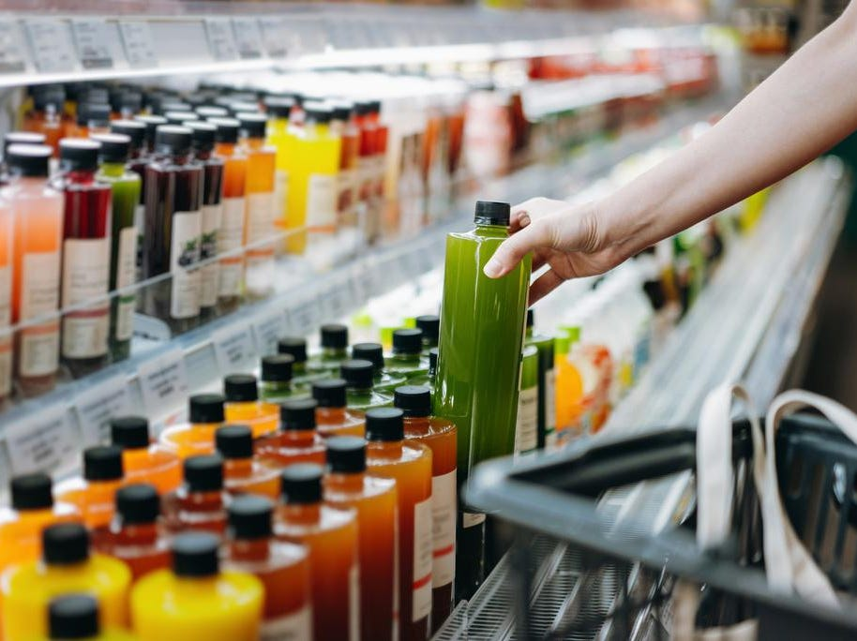
Executive Summary
Beverage Industry Highlights
Market volume, from 696.1 Liters to 994.1 (2009 to 2018)
PepsiCo, 342 new non-alcoholic beverage (January 2016 and February 2021)
Anheuser-Busch InBev, global learning company with over 54 million U.S. dollars sales
Problem Statement
An Australian company which has beverage business has needs to forecast sales for each product. The company already has a in-house solution for predicting sales. However, they want to seek solutions based on AI/ML.
Exploratory Data Analysis Approach
Seaborn, matplotlib.pyplot
ydata_profiling

Slide 4
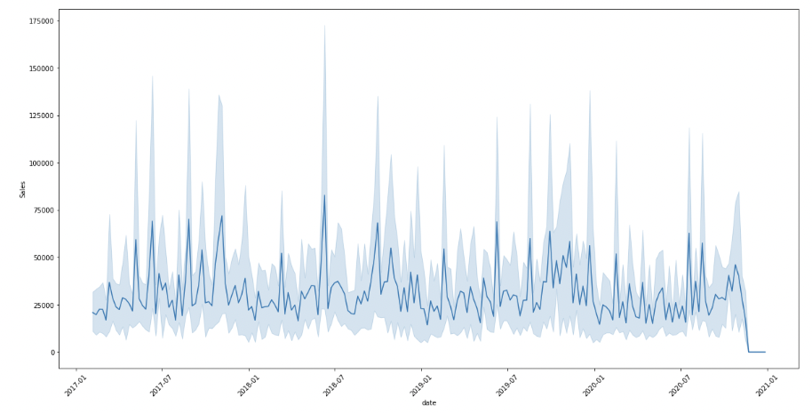
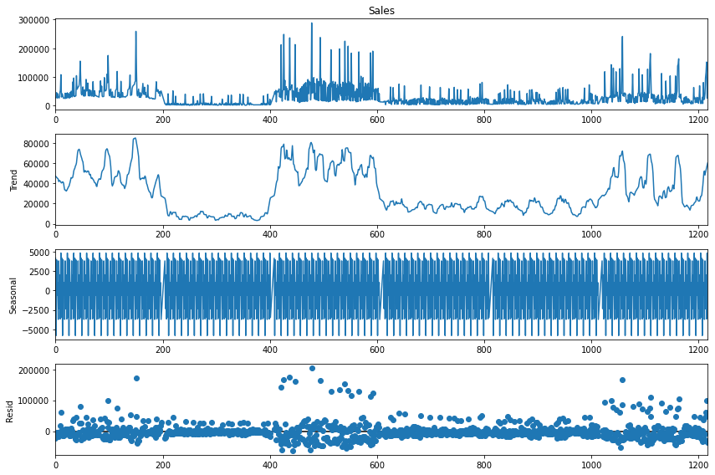
Exploratory Data Analysis
Sales overtime
Decomposition of Sales (Trend, Seasonality, Residuals)
By checking how sales perform overtime, it is evident that seasonality exists
Further decomposition shows that there is a non-linear and additive trend with seasonality
The series is stationary as no pattern appears in the residual plot

Slide 5
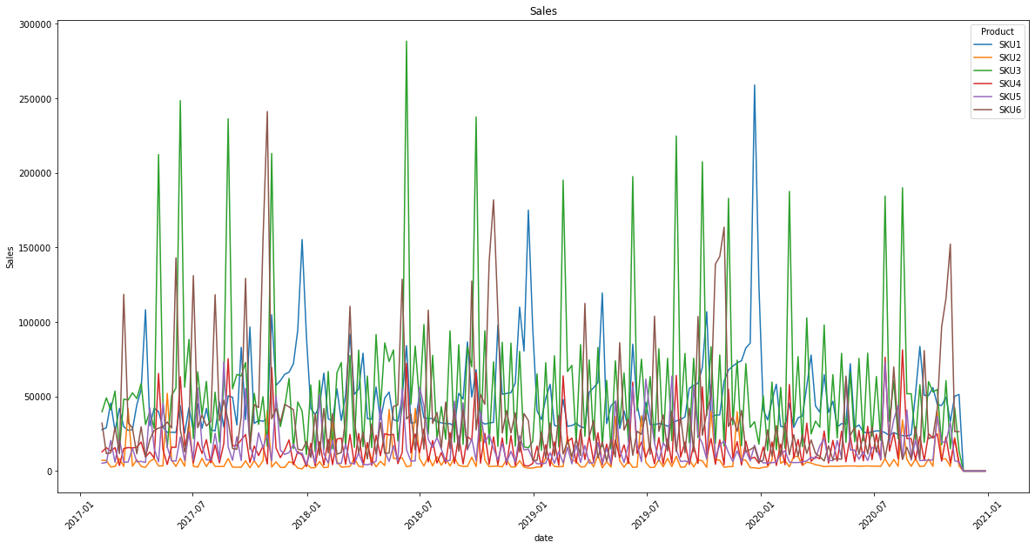
Exploratory Data Analysis
Here we first demonstrate the overall distribution of sales over time.

Slide 6
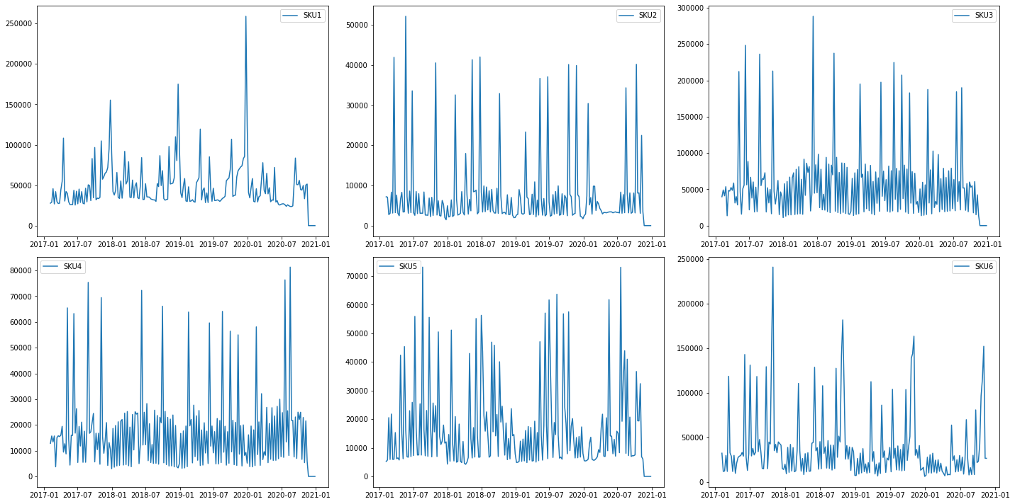
Exploratory Data Analysis
Here we explore the overall distribution of sales by product over time.

Slide 7
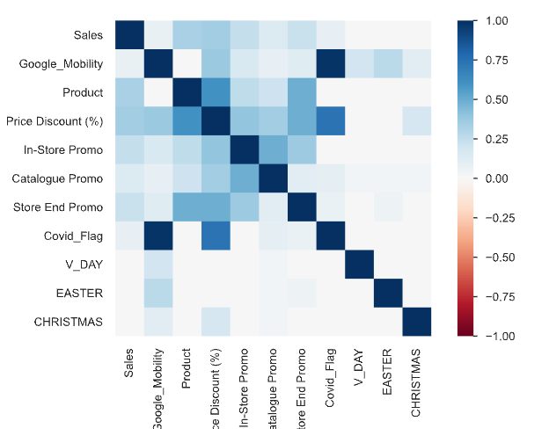
Exploratory Data Analysis
Discover the correlation:
Besides the last three features, Sales has positive correlation with all other features to different extents.
The noticeable correlations:
Sales with Price Discount (%) - 0.347978
Product with Price Discount (%) - 0.603060
Covid_Flag with Price Discount (%) - 0.734857
Covid_Flag with Google Mobility - 0.982582

Slide 8
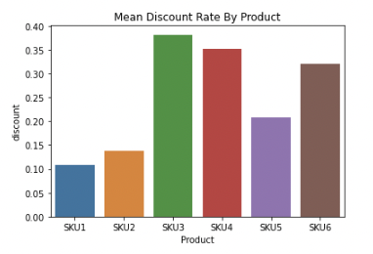
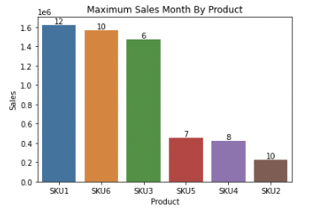
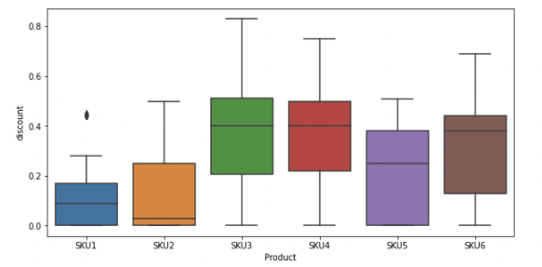
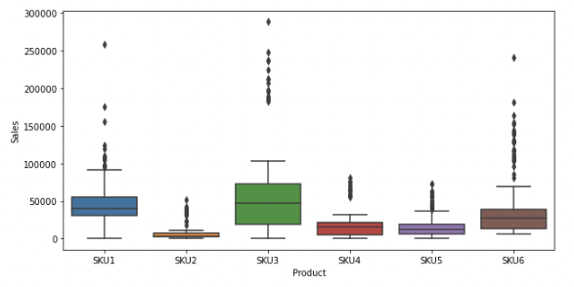
Exploratory Data Analysis
From sales by product boxplot, SKU3 is the product that performs relatively better
SKU6 and SKU3 are products which have higher sales because of heavy discount
SKU1 is the product that rarely has discount but still incur high sales
SKU4 has a wide range of discount but sales amount is bad

Slide 9
Recommendations
To sum up, we recommend to try the following models based on our EDA:
ARIMA
SARIMA
Prophet (Cope with nonlinear trend with seasonality)
DeepAR (Recurrent Neural Network)
LSTM
Linear Regression with external factors

Slide 10
Thank You

